Slide 1
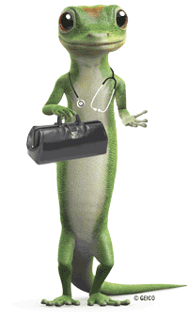
Doctor Gecko
A Smart eye on the ISS
Milan, 20-21 October 2018

Slide 2
Challenge: Can you built a… Design by nature Group: Dr. Gecko Group Members: Felice Damiano Lorenzo Palmiotti Serena Suriano Valeria Trozzi
Nasa Space apps challenge 2018

Slide 3
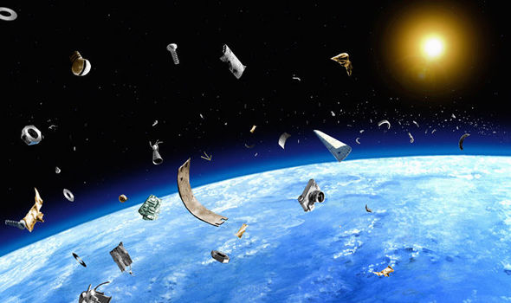
What’s the problem?
Micro-Meteoroid and Orbital Debris (MMOD) threaten the “health” of our satellites
Credit: Chris Butler | Getty Images

Slide 4
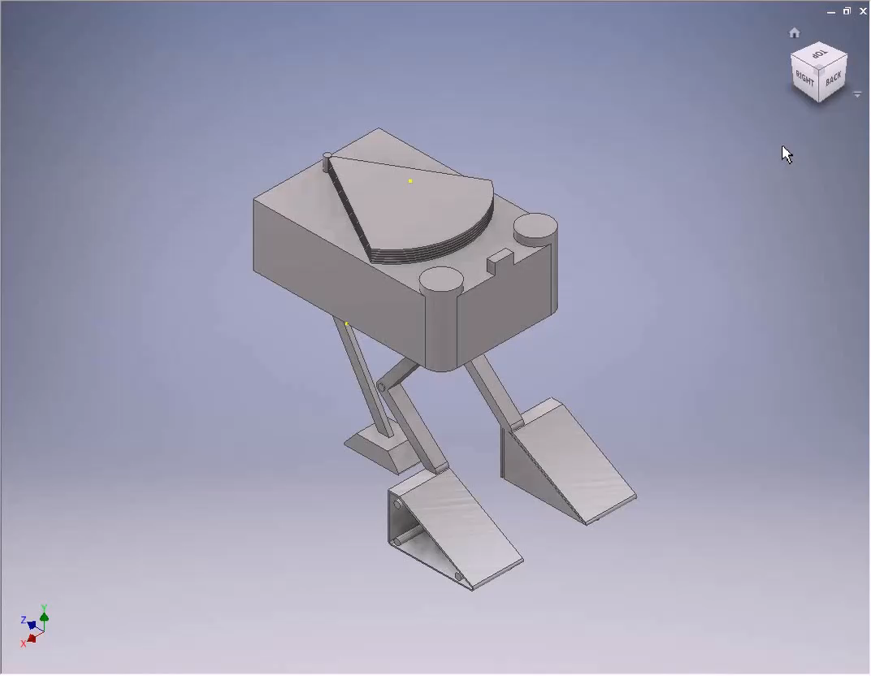
Doctor Gecko finds the damage for you!

Slide 5
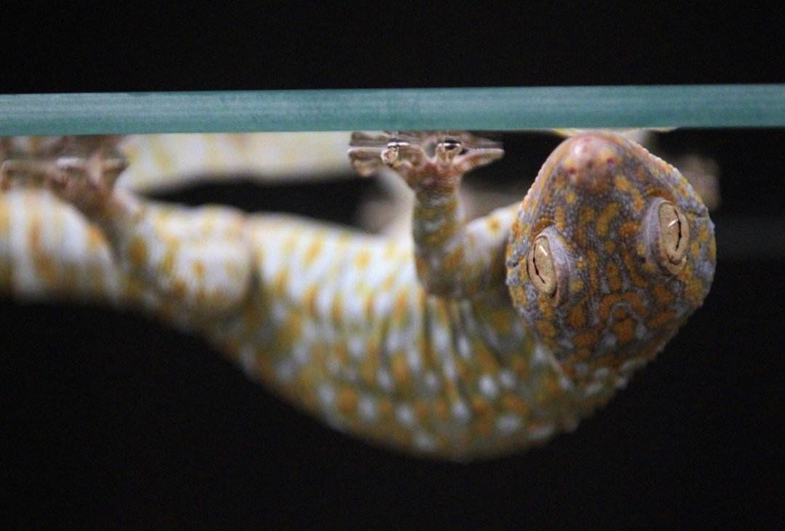
What Makes Gecko Feet So Sticky?
The key is a tiny invisible wedge
Gecko's foot setae
Synthetic tiny wedge
Our track
Credit: Steemd

Slide 6
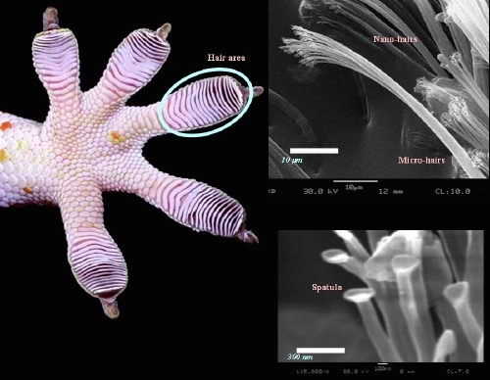
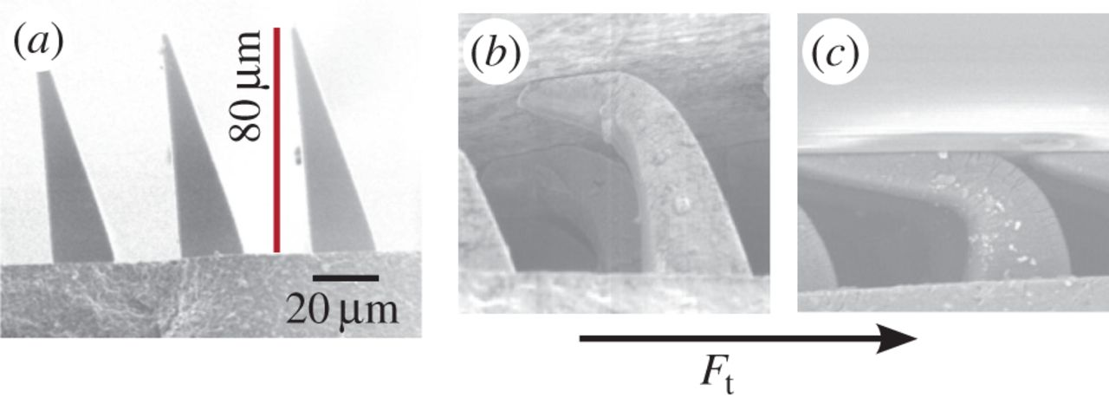
Tecnology
Van Der Waals forces
Increase of the contact surface
Need of moment for the posting
Credit: Pinterest
Credit: Royal Society Publishing

Slide 7
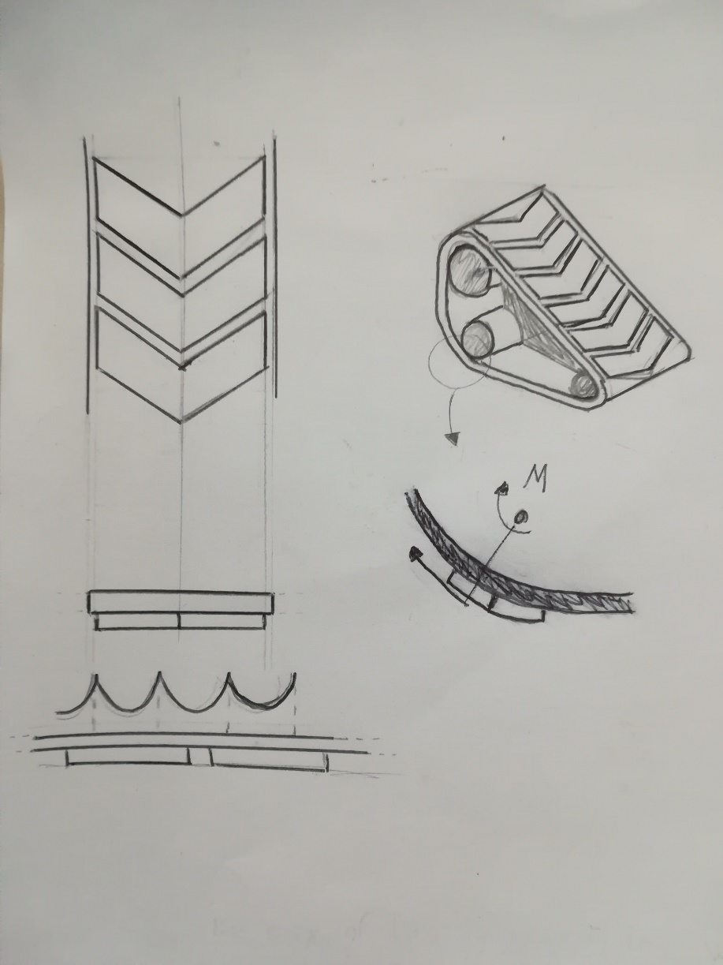
But why a track-laying instead of sticky feet?
Rapidity
Excellent adhesion on the surface
Optimized shape to facilitate the separation from surface of the adhesive

Slide 8
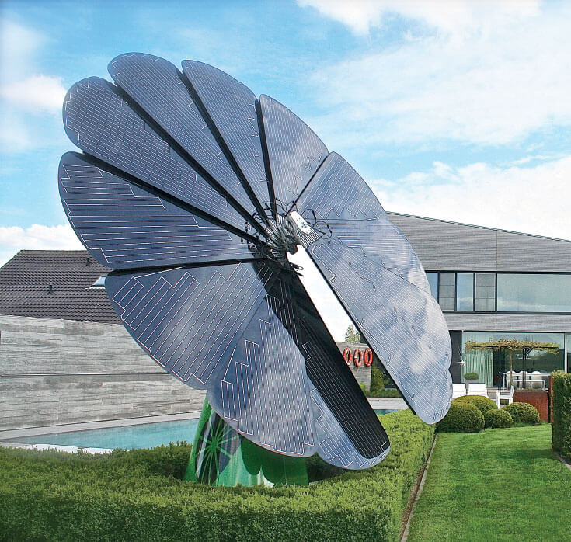
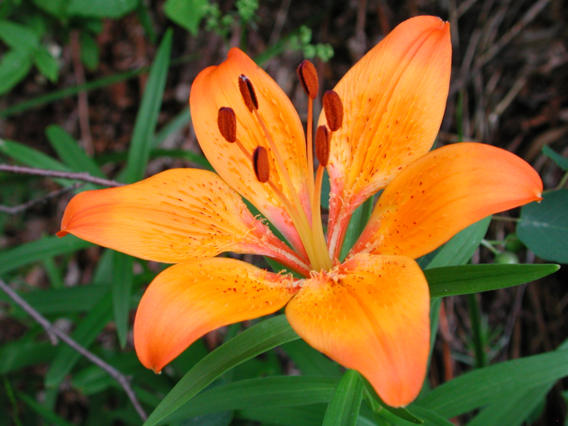
Energy
Secondary battery
‘Flower’ solar panels
Credit: Multisun

Slide 9
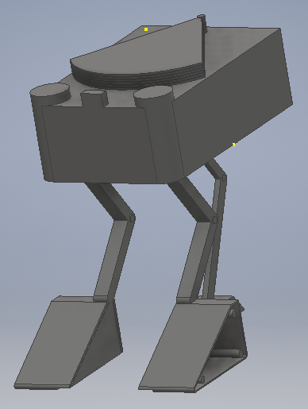
What are the tools of the trade?
Optical camera on a robotic arm in the front of the vehicle
Two 3D Scanners on the two front edge for a wider view
A map of the structure integrated in the on-board computer for autonomous operation
Possibility to add special module to temporary repair the damage

Slide 10
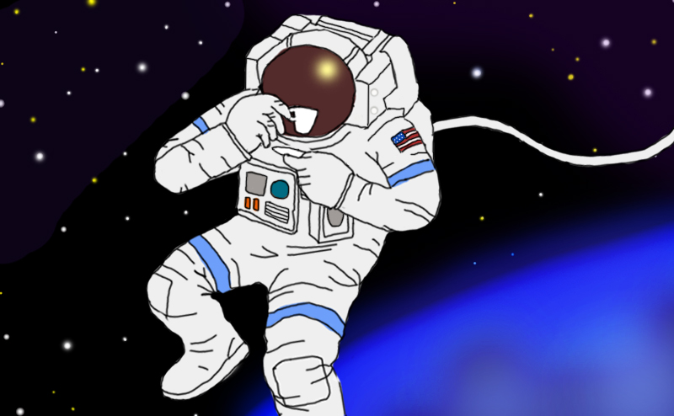
Doctor Gecko semplifies your life
You can take a break while Doctor Gecko works
Faster and safer identification of the damages
Target intervention thanks to data collected by the free-flyer
Credit: David Reneke

